Slide 1
Predicting numeric values: Regression
S Lab Talk Series
Presentation by
Sasmita Pandey

Slide 2
Goal
In the generalized prediction task we have
Regression task - :when it is required to estimate the continuous predictive value.
Classification task.- :when it is required to determine which category the dependent variable belongs to.
Use Regression to Predict Numeric Target value.

Slide 3
Approach
Linear regression algorithm shows a linear relationship between a dependent (y) and one or more independent (x) variables, hence called as linear regression.
Since linear regression shows the linear relationship, which means it explains the impact of changes in Independent Variable on Dependent variable.

Slide 4
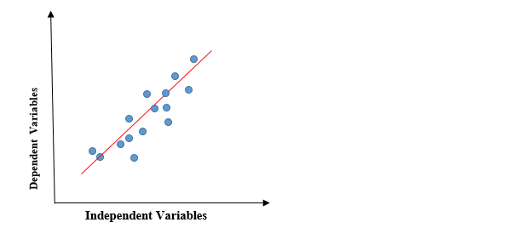
The core idea is to obtain a line that best fits the data.
The best fit line is the one for which total prediction error (all data points) are as small as possible.

Slide 5
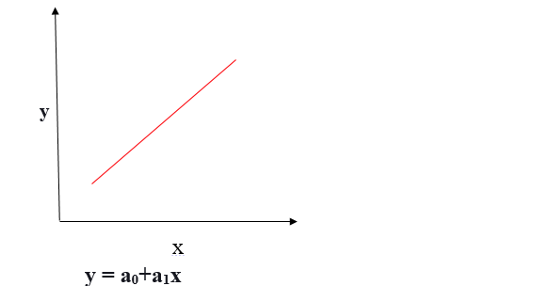
Positive Linear Relationship
If the dependent variable expands on the Y-axis and the independent variable progress on X-axis, then such a relationship is termed a Positive linear relationship.

Slide 6
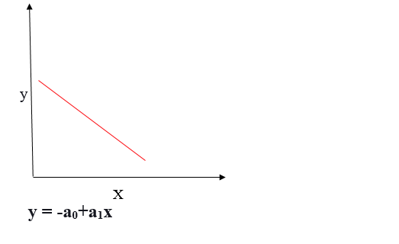
Negative Linear Relationship
If the dependent variable decreases on the Y-axis and the independent variable increases on the X-axis, such a relationship is called a negative linear relationship.

Slide 7


Starting with writing Equation for Target value with respect to inputs:
Example:
Input data is in matrix X and regression weights are vector w.
For given piece of data X1 , Predicted value will be given by

Slide 8
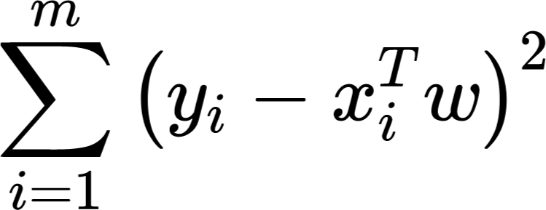
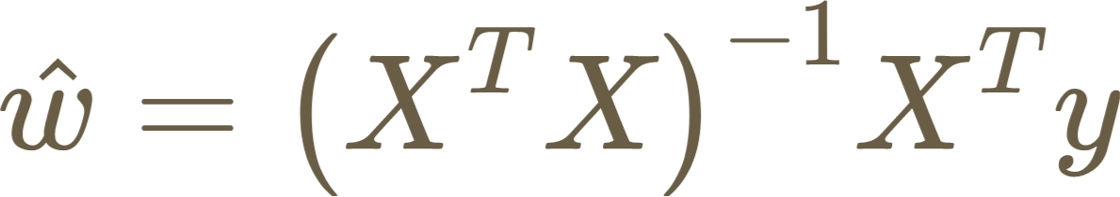
How to find the weights
Minimizing the error (difference between predicted y and actual y) by squaring the error
w is calculated as

Slide 9
Locally Weighted Linear Regression
Linear regression tends to underfit the Data, and then we don’t get the best predictions.
Locally weighted regression is inspired by cases when linear regression, which simply fits a line, isn’t sufficient, but we don’t want to overfit either.
we don’t always know how our data will look like, If it’s linear, then linear regression does a good job.

Slide 10
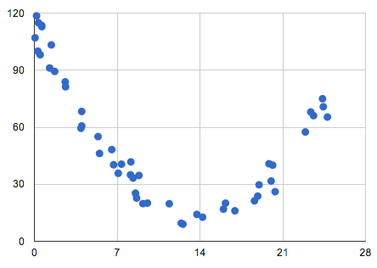
Sometimes, it could be a parabola

Slide 11
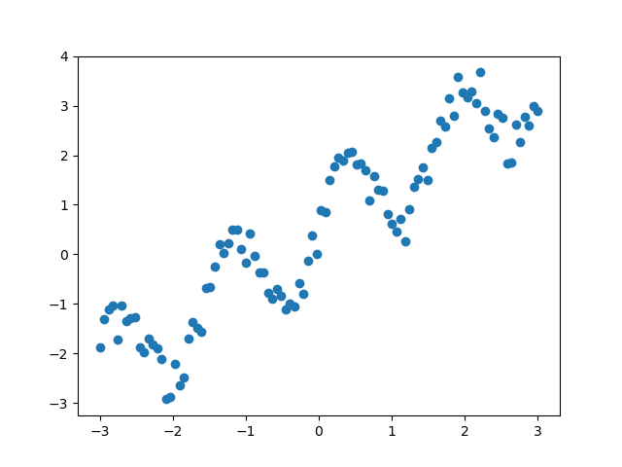
Sometimes, it maybe sinusoidal

Slide 12
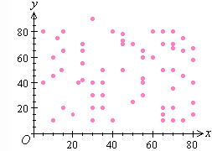
and sometimes it may just be all over the place.

Slide 13
Linear Regression gives us the lowest mean square error for unbiased estimators.
Locally weighted Linear Regression: It is a way to reduce the mean-square error.
The points near to the test point are a good way to estimate the value we should predict giving more weightage to points in the training data that are close to the point we want to make a prediction on.

Slide 14
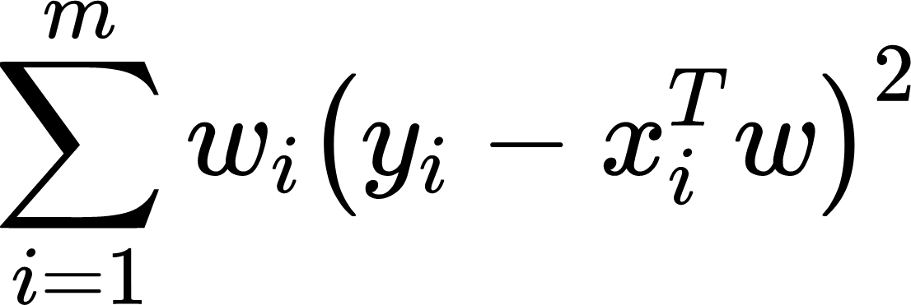
In Linear regression, we had the following loss function —
The modified loss for locally weighted regression —

Slide 15
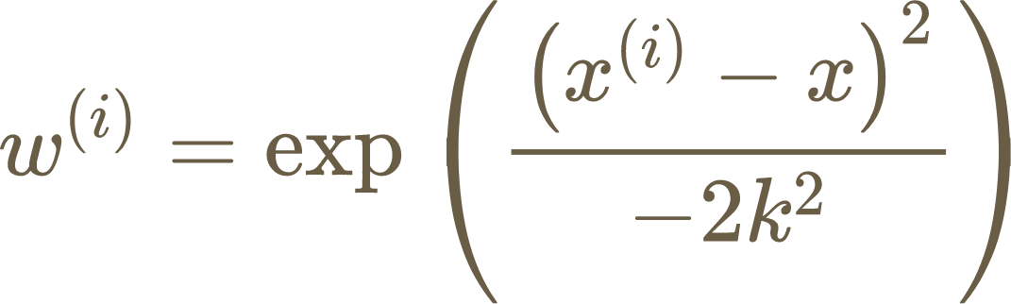
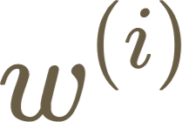
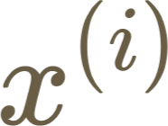
The kernel assigns a weight given by
is a non-negative “weight” associated with training point
K is called the bandwidth parameter and controls the rate at which falls with distance from
k determines how much to weigh nearby points.This in effect determines the width of the kernel.

Slide 16
Locally weighted linear regression is a supervised learning algorithm.
It a non-parametric algorithm.
There exists No training phase. All the work is done during the testing phase/while making predictions.
When to use
When n (number of features) is small.
If you don’t want to think about what features to use

